Slide 1

Data Link Layer
Lecture 15 | CSE421 –Computer Networks
Department of Computer Science and Engineering School of Data & Science

Slide 2


Based on Chapter 6 The Link Layer and LANs
Computer Networking: A Top Down Approach
7th edition Jim Kurose, Keith Ross Pearson/Addison Wesley April 2016
The slides are adapted from Kurose and Ross, Computer Networks 7th edition, Kurose and Ross.
All material copyright 1996-2016
J.F Kurose and K.W. Ross, All Rights Reserved

Slide 3
Chapter 6: Link layer and LANs
Objectives:
understand principles behind link layer services:
error detection, correction (done in CSE320)
sharing a broadcast channel: multiple access (done in CSE320)
Framing - link layer addressing
ARP
local area networks: Ethernet

Slide 4
Application
Presentation
Session
Transport
Introduction to Link Layer
Network
Data link
Physical

Slide 5
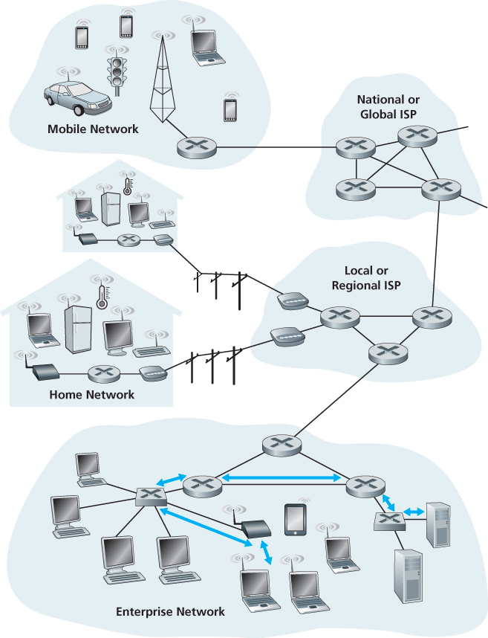
Link Layer Terminology
Nodes : hosts and routers
Links:
wired links
wireless links
Frame : layer-2 packet
data-link layer has responsibility of
transferring datagram from one node
to physically adjacent node over a link

Slide 6
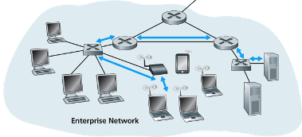
Link layer: context
datagram transferred by different link protocols over different links:
e.g., Ethernet on first link, frame relay on intermediate links, 802.11 on last link
each link protocol provides different services
Transportation analogy:
trip from Home to Cox’s Bazaar
Uber Car : Home to Dhaka Airport
Plane: Dhaka to Chittagong
Bus: Chittagong to Cox’s Bazaar
tourist = datagram
transport segment = communication link
transportation mode = link layer protocol
travel agent = routing algorithm
WAN Protocol : Frame Relay
Ethernet
Ethernet
802.11

Slide 7
Link layer functions/services
Framing
encapsulate datagram into frame, adding header, trailer
Various information added such as the various protocols
“MAC” addresses used in frame headers to identify source, destination
different from IP address!
Link access:
how to send a frame to the link
channel access if shared medium
Control/Avoid clashes in multi-access networks!
rules to follow when sending the link
Reliable delivery between adjacent nodes
we learned how to do this already (Transport Layer)
seldom used on low bit-error link (fiber, some twisted pair)
wireless links: high error rates
Q: why both link-level and end-end reliability?

Slide 8
Link layer services (more)
error detection:
errors caused by signal attenuation, noise.
receiver detects presence of errors:
signals sender for retransmission or drops frame
error correction:
receiver identifies and corrects bit error(s) without resorting to retransmission (there are various protocols)
flow control:
pacing between adjacent sending and receiving nodes
half-duplex and full-duplex
with half duplex, nodes at both ends of link can transmit, but not at same time

Slide 9
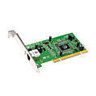
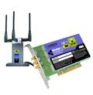

Where is the link layer implemented?
in each and every host
link layer implemented in “adaptor” (aka network interface card NIC) or on a chip
Ethernet card, 802.11 card; Ethernet chipset
implements link, physical layer
attaches into host’s system buses
combination of hardware, software, firmware
application
transport
network
link
cpu
memory
link
physical
host
bus
(e.g., PCI)
controller
physical
transmission
network adapter
card

Slide 10
Adaptors communicating
datagram
datagram
controller
controller
sending host
receiving host
datagram
frame
sending side:
encapsulates datagram in frame
adds error checking bits, rdt, flow control, etc.
receiving side
looks for errors, rdt, flow control, etc.
extracts datagram, passes to upper layer at receiving side

Slide 11
Objectives – Part 1
Our objectives
Link Layer Addressing
MAC Address
Types of MAC Addresses
ARP
ARP within LAN
LAN Protocol
Ethernet
LAN Switch

Slide 12
Link Layer Addressing

Slide 13
IP Address vs MAC Address
MAC address
48 bits
12 Hexadecimal digits
Example : 1A-2F-BB-76-09-AD
Data Link-layer address for interface
Flat
portable
Function
IP address
32 bits
Dotted decimal notation
Example : 192.168.10.1
Network-layer address for interface
Hierarchal
Not portable
Function

Slide 14
MAC or LAN or Physical or Ethernet addresses (more)
48 bits MAC address (for most LANs) burned in NIC ROM, also sometimes software settable
MAC address allocation administered by IEEE
Manufacturer buys portion of MAC address space (to assure uniqueness)
Analogy:
MAC address: like National ID
IP address: like Postal Address

Slide 15
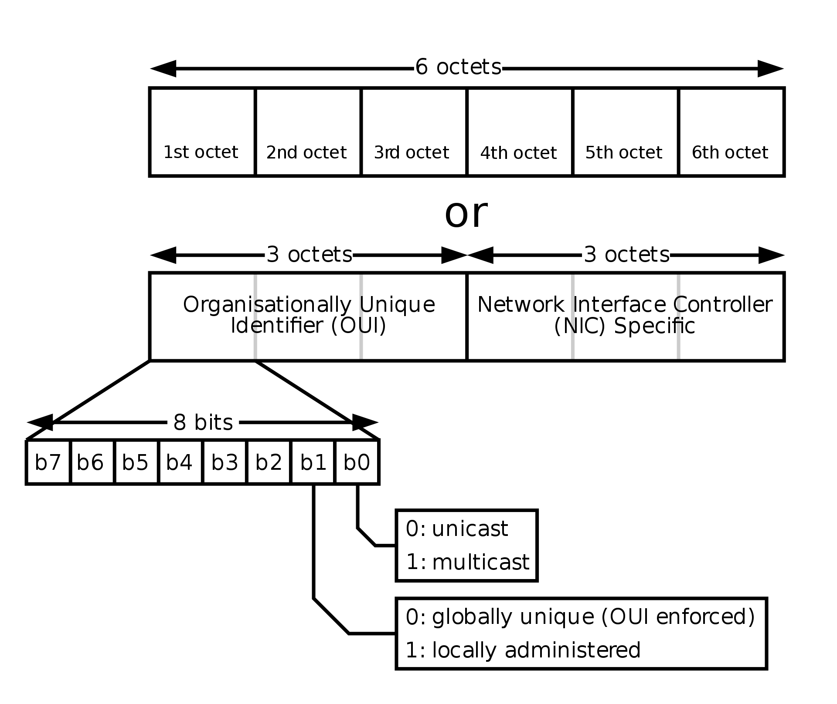


MAC Address
48 bits MAC address (for most LANs) burned in NIC ROM, also sometimes software settable
0000
1100
hexadecimal (base 16) notation
(each “numeral” represents 4 bits)

Slide 16
Types of MAC Address
Unicast
MAC Address
Multicast
Broadcast

Slide 17
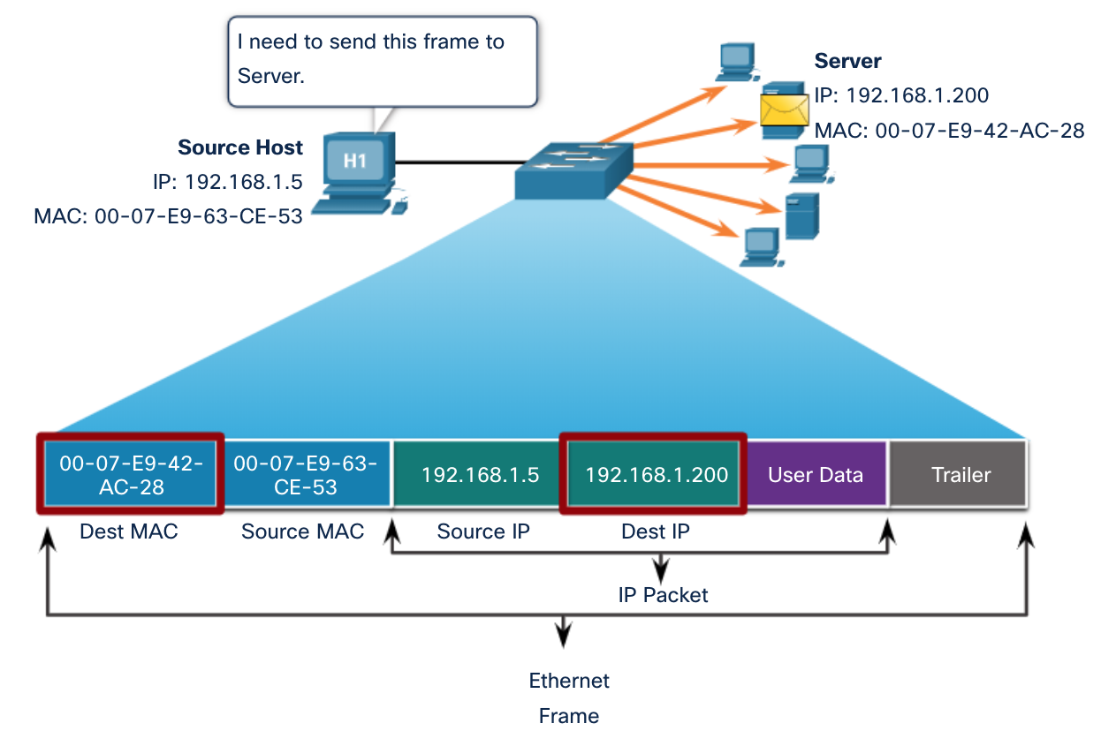
Unicast MAC Addresses
The unique address used when a frame is sent from a single transmitting device to a single destination device.

Slide 18
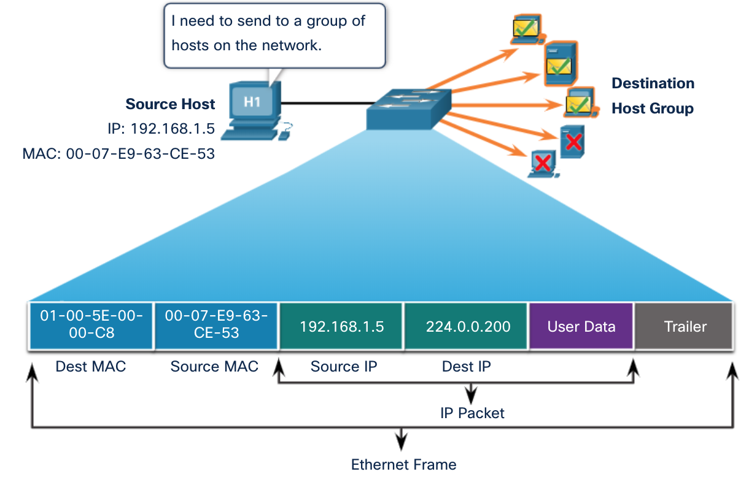
Multicast MAC Addresses
“ 01-00-5E” in an IPv4 multicast packet

Slide 19
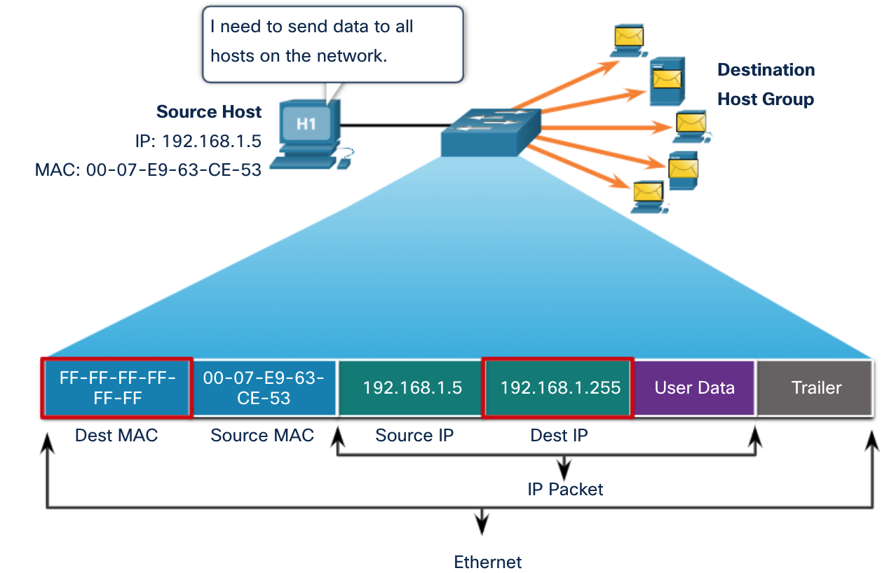
Broadcast MAC Address
A destination MAC address of FF-FF-FF-FF-FF-FF
To be processed by all devices in the network

Slide 20
LAN addresses and ARP
each adapter on LAN has unique LAN address
1A-2F-BB-76-09-AD
LAN
(wired or
wireless)
adapter
71-65-F7-2B-08-53
58-23-D7-FA-20-B0
0C-C4-11-6F-E3-98

Slide 21


ARP: address resolution protocol
Question: how to determine
interface’s MAC address, knowing its IP address?
ARP
Mapping _IP Add___ to _MAC Add____
ARP table
IP
MAC address
TTL (Time To Live) Or Age
time after which address mapping will be forgotten (typically 20 min)
137.196.7.78
1A-2F-BB-76-09-AD
137.196.7.23
137.196.7.14
LAN
71-65-F7-2B-08-53
58-23-D7-FA-20-B0
0C-C4-11-6F-E3-98
137.196.7.88

Slide 22
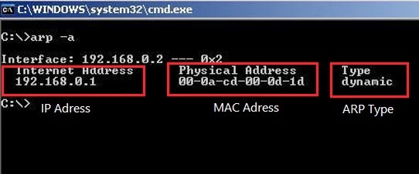
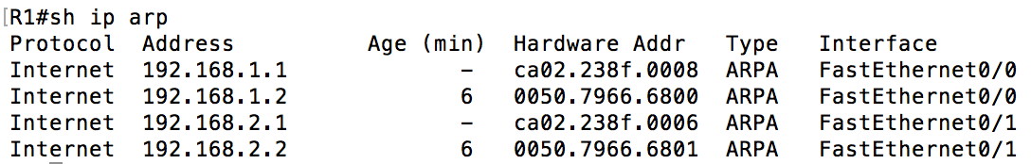
ARP Tables
Host or PC
Router

Slide 23
ARP: address resolution protocol
X
137.196.7.78
A wants to send datagram to B
1A-2F-BB-76-09-AD
137.196.7.23
ARP
137.196.7.14
A
ARP Reply
✔️
LAN
B
ARP
ARP
ARP
71-65-F7-2B-08-53
58-23-D7-FA-20-B0
0C-C4-11-6F-E3-98
137.196.7.88
X
71-65-F7-2B-08-53 | 58-23-D7-FA-20-B0 | 137.196.7.23 | 137.196.7.14 | ARP Reply
 | 71-65-F7-2B-08-53 | 137.196.7.14 | 137.196.7.23 | ARP Request
FF-FF-FF-FF-FF-FF
Dest MAC | Source MAC | Dest IP Add | Source IP Add | ARP Req/Reply

Slide 24
ARP protocol: same LAN
A wants to send datagram to B
B’s MAC address not in A’s ARP table.
A broadcasts ARP query packet, containing B's IP address
destination MAC address = FF-FF-FF-FF-FF-FF
all nodes on LAN receive ARP query
B receives ARP packet, replies to A with its (B's) MAC address
frame sent to A’s MAC address (unicast)
A caches (saves) IP-to-MAC address pair in its ARP table
Soft state: information that times out (goes away) unless refreshed
ARP is “plug-and-play”:
nodes create their ARP tables without intervention from net administrator
Notes:
until information becomes old (times out)

Slide 25
Addressing: routing to another LAN
Send datagram from A to B via R
focus on addressing – at IP (datagram) and MAC layer (frame)
assume A knows B’s IP address
What will be the destination MAC Address?
ARP- To know B’s MAC address as B’s IP address is known
Routers never forward broadcast packets!
A
B
R
111.111.111.111
222.222.222.222
74-29-9C-E8-FF-55
222.222.222.220
49-BD-D2-C7-56-2A
1A-23-F9-CD-06-9B
111.111.111.112
111.111.111.110
222.222.222.221
CC-49-DE-D0-AB-7D
E6-E9-00-17-BB-4B
88-B2-2F-54-1A-0F
 |  | 222.222.222.222 | 111.111.111.111 | A to B Packet
Default Gateway’s MAC Address
???
74-29-9C-E8-FF-55
Dest MAC | Source MAC | Dest IP Add | Source IP Add | Packet Type

Slide 26
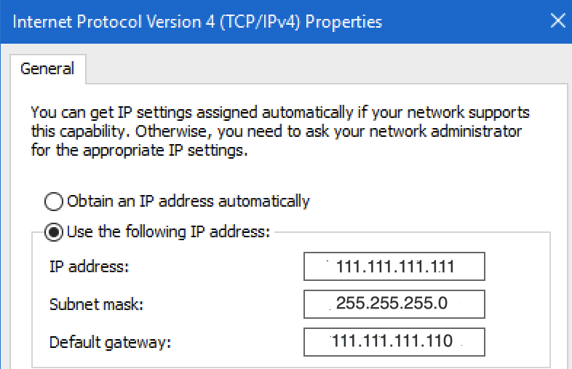
Addressing: routing to another LAN
Send datagram from A to B via R
Does A know the IP address of first hop router, R which is also known as Default Gateway? (how?)
Will A know R’s MAC address?
ARP
A
B
R
ARP
ARP Reply
111.111.111.111
ARP
222.222.222.222
74-29-9C-E8-FF-55
49-BD-D2-C7-56-2A
222.222.222.220
1A-23-F9-CD-06-9B
111.111.111.112
111.111.111.110
222.222.222.221
CC-49-DE-D0-AB-7D
E6-E9-00-17-BB-4B
88-B2-2F-54-1A-0F
 | 74-29-9C-E8-FF-55 | 222.222.222.222 | 111.111.111.111 | A to B Packet
E6-E9-00-17-BB-4B

Slide 27
Addressing: routing to another LAN
A creates IP datagram with IP source A, destination B
A creates link-layer frame with R's MAC address as destination address, frame contains A-to-B IP datagram
MAC src: 74-29-9C-E8-FF-55
MAC dest: E6-E9-00-17-BB-4B
IP
Eth
Phy
IP src: 111.111.111.111
IP dest: 222.222.222.222
A
B
R
111.111.111.111
222.222.222.222
74-29-9C-E8-FF-55
49-BD-D2-C7-56-2A
1A-23-F9-CD-06-9B
111.111.111.110
222.222.222.220
222.222.222.221
111.111.111.112
E6-E9-00-17-BB-4B
CC-49-DE-D0-AB-7D
88-B2-2F-54-1A-0F

Slide 28
Addressing: routing to another LAN
frame sent from A to R
frame received at R, datagram removed, passed up to IP
MAC src: 74-29-9C-E8-FF-55
MAC dest: E6-E9-00-17-BB-4B
IP src: 111.111.111.111
IP dest: 222.222.222.222
IP
Eth
Phy
IP src: 111.111.111.111
IP dest: 222.222.222.222
IP
Eth
Phy
A
B
R
111.111.111.111
222.222.222.222
74-29-9C-E8-FF-55
49-BD-D2-C7-56-2A
222.222.222.220
1A-23-F9-CD-06-9B
111.111.111.112
111.111.111.110
222.222.222.221
CC-49-DE-D0-AB-7D
E6-E9-00-17-BB-4B
88-B2-2F-54-1A-0F

Slide 29
Addressing: routing to another LAN
R forwards datagram with IP source A, destination B
R creates link-layer frame with B's MAC address as destination address, frame contains A-to-B IP datagram
MAC src: 1A-23-F9-CD-06-9B
MAC dest: 49-BD-D2-C7-56-2A
IP
Eth
Phy
IP
Eth
Phy
IP src: 111.111.111.111
IP dest: 222.222.222.222
A
ARP Reply
B
R
111.111.111.111
ARP
222.222.222.222
74-29-9C-E8-FF-55
ARP
ARP
49-BD-D2-C7-56-2A
222.222.222.220
1A-23-F9-CD-06-9B
111.111.111.112
111.111.111.110
222.222.222.221
CC-49-DE-D0-AB-7D
E6-E9-00-17-BB-4B
88-B2-2F-54-1A-0F

Slide 30
Addressing: routing to another LAN
R forwards datagram with IP source A, destination B
R creates link-layer frame with B's MAC address as destination address, frame contains A-to-B IP datagram
MAC src: 1A-23-F9-CD-06-9B
MAC dest: 49-BD-D2-C7-56-2A
IP
Eth
Phy
IP
Eth
Phy
IP src: 111.111.111.111
IP dest: 222.222.222.222
A
B
R
111.111.111.111
222.222.222.222
74-29-9C-E8-FF-55
49-BD-D2-C7-56-2A
222.222.222.220
1A-23-F9-CD-06-9B
111.111.111.112
111.111.111.110
222.222.222.221
CC-49-DE-D0-AB-7D
E6-E9-00-17-BB-4B
88-B2-2F-54-1A-0F

Slide 31
Addressing: routing to another LAN
R forwards datagram with IP source A, destination B
R creates link-layer frame with B's MAC address as dest, frame contains A-to-B IP datagram
MAC src: 1A-23-F9-CD-06-9B
MAC dest: 49-BD-D2-C7-56-2A
IP src: 111.111.111.111
IP dest: 222.222.222.222
IP
Eth
Phy
A
B
R
111.111.111.111
222.222.222.222
74-29-9C-E8-FF-55
49-BD-D2-C7-56-2A
222.222.222.220
1A-23-F9-CD-06-9B
111.111.111.112
111.111.111.110
222.222.222.221
CC-49-DE-D0-AB-7D
E6-E9-00-17-BB-4B
88-B2-2F-54-1A-0F
* Check out the online interactive exercises for more examples: http://gaia.cs.umass.edu/kurose_ross/interactive/

Slide 32
Objectives – Part II
LAN Protocol : Ethernet
Ethernet Frame Structure
Features of Ethernet
Types of Ethernet
Switches in Ethernet

Slide 33

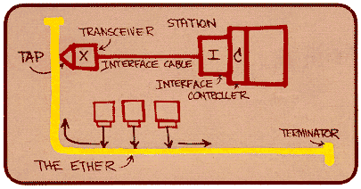
Ethernet
“Dominant” wired LAN technology
Cheap
First
Simple
Fast : 10 Mbps – 10 Gbps
Metcalfe’s Ethernet sketch

Slide 34

Ethernet: physical topology
Bus
popular through mid 90s
All nodes in same collision domain
Star
prevails today
Active switch in center
Nodes do not collide with each other
switch
bus: coaxial cable
star

Slide 35
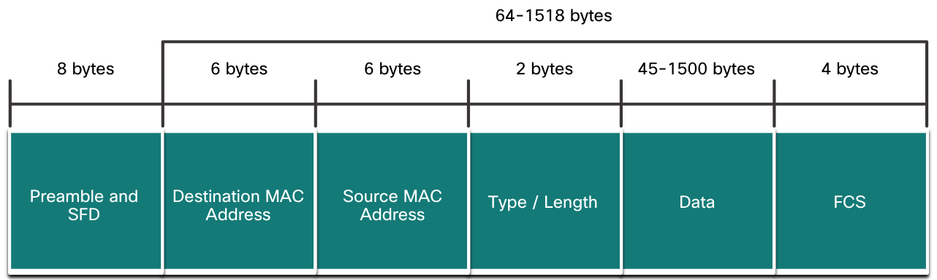
Ethernet Frame Structure
Ethernet Frame
Sending adapter encapsulates IP datagram (or other network layer protocol packet) with header and trailer
Header | Data | Trailer
46 -1500 bytes
Header
Trailer

Slide 36
Ethernet Frame Structure
Preamble
Dest
Address
Source
Address
Type
Data
CRC
Preamble:
8 bytes
Seven of ‘10101010’ patterns
One ‘10101011’ pattern -> SFD (Start Frame Delimiter)
used to synchronize receiver, sender clock rates

Slide 37
Ethernet Frame Structure
Preamble
Dest
Address
Source
Address
Type
Data
CRC
Destination and Source addresses
6 bytes source & destination MAC addresses
Type
Indicates higher layer protocol (E.g. mostly IP)
IPv4? IPv6? Any other?
Allows to multiplex network layer protocols or ARP
Notes:
if adapter receives frame with matching destination address, or with broadcast address (e.g. ARP packet), it passes data in frame to network layer protocol
otherwise, adapter discards frame

Slide 38
Ethernet Frame Structure
Preamble
Dest
Address
Source
Address
Type
Data
CRC
Data field
Contains IP datagram
Min 46 bytes and max 1500 bytes
CRC/FCS/Checksum
Cyclic redundancy check at receiver
error detected: frame is dropped
Notes:
if adapter receives frame with matching destination address, or with broadcast address (e.g. ARP packet), it passes data in frame to network layer protocol
otherwise, adapter discards frame

Slide 39
Ethernet: unreliable, connectionless
Connectionless: no handshaking between sending and receiving NICs
unreliable: receiving NIC doesn't send acks or nacks to sending NIC
data in dropped frames recovered only if initial sender uses higher layer rdt (e.g., TCP), otherwise dropped data lost
Ethernet’s MAC protocol: unslotted CSMA/CD with binary backoff
Hub has collision domains, switch doesn’t.

Slide 40
802.3 Ethernet standards: link & physical layers
Many different Ethernet standards
common MAC protocol and frame format
different speeds: 2 Mbps, 10 Mbps, 100 Mbps, 1Gbps, 10 Gbps, 40 Gbps
different physical layer media: fiber, cable
application
transport
network
link
physical
MAC protocol
and frame format
100BASE-TX
100BASE-T2
100BASE-FX
100BASE-T4
100BASE-SX
100BASE-BX
copper (twister
pair) physical layer
fiber physical layer

Slide 41
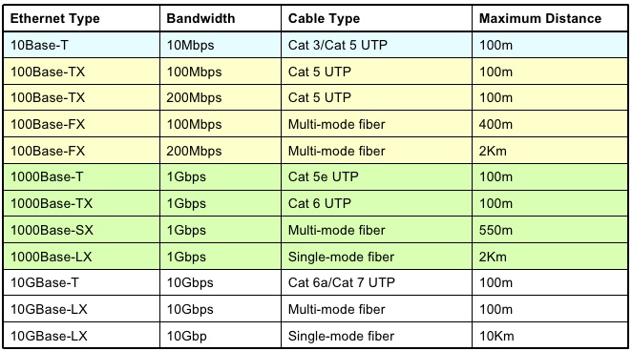

Slide 42
Objectives – Part III
Switch
Characteristics of a switch
Role of switch in a LAN

Slide 43
Ethernet switch
link-layer device: takes an active role
store, forward Ethernet frames
examine incoming frame’s MAC address, selectively forward frame to one-or-more outgoing links when frame is to be forwarded on segment, uses CSMA/CD to access segment
transparent
hosts are unaware of presence of switches
plug-and-play, self-learning
switches do not need to be configured

Slide 44
Switch: multiple simultaneous transmissions
hosts have dedicated, direct connection to switch
switches buffer packets
Ethernet protocol used on each incoming link, but no collisions; full duplex
each link is its own collision domain
switching: A-to-A’ and B-to-B’ can transmit simultaneously, without collisions
A
C’
B
6
1
2
5
4
3
B’
C
A’
switch with six interfaces
(1,2,3,4,5,6)

Slide 45
Switch forwarding table
Q: how does switch know A’ reachable via interface 4, B’ reachable via interface 5?
A
C’
B
A: each switch has a switch table, each entry:
(MAC address of host, interface to reach host, time stamp)
looks like a routing table!
6
1
2
5
4
3
B’
C
Q: how are entries created, maintained in switch table?
something like a routing protocol?
A’
switch with six interfaces
(1,2,3,4,5,6)

Slide 46
Switch: self-learning
Source: A
Dest: A’
The table is empty initially
switch learns which hosts can be reached through which interfaces
when frame received, switch “learns” location of sender: incoming LAN segment
records sender/location pair in switch table
A
A A’
C’
B
6
1
2
5
4
3
B’
C
A’
MAC addr interface TTL
A
1
60
Switch table
(initially empty)

Slide 47
Switch: frame filtering/forwarding
when frame received at switch:
1. record incoming link, MAC address of sending host
2. index switch table using MAC destination address
3. if entry found for destination then {
if destination on segment from which frame arrived then drop frame
else forward frame on interface indicated by entry
}
else flood /* forward on all interfaces except arriving
interface */

Slide 48
Self-learning, forwarding: example
Source: A
Dest: A’
A
A A’
frame destination, A’, location unknown:
flood
C’
B
destination A location known:
6
1
2
A A’
A A’
A A’
A A’
selectively send
on just one link
A A’
5
4
3
B’
C
A’ A
A’
MAC addr interface TTL
A
1
60
switch table
(initially empty)
A’
4
60

Slide 49

Interconnecting switches
self-learning switches can be connected together:
S₄
S₁
S₃
A
S₂
F
I
B
C
D
E
G
H
Q: sending from A to G - how does S₁ know to forward frame destined to G via S₄ and S₃?
A: self learning! (works exactly the same as in single-switch case!)

Slide 50
Self-learning multi-switch example
Suppose C sends frame to I, I responds to C
S₄
S₁
S₃
A
S₂
F
I
B
C
D
E
G
H
Q: show switch tables and packet forwarding in S₁, S₂, S₃, S₄

Slide 51
Institutional network
mail server
to external
network
router
web server
IP subnet

Slide 52
Switches vs. routers
application
transport
network
link
physical
both are store-and-forward:
routers: network-layer devices (examine network-layer headers)
switches: link-layer devices (examine link-layer headers)
both have forwarding tables:
routers: compute tables using routing algorithms, IP addresses
switches: learn forwarding table using flooding, learning, MAC addresses
datagram
frame
link
physical
frame
switch
network
link
physical
datagram
frame
application
transport
network
link
physical

Slide 53
THE END!

